Slide 1
Food Waste Management System
DBMS Mini Project | Database Management Systems
Vinit Patil - Roll No. 14 - PRN 1262252115
Siddhesh Patil - Roll No. 20 - PRN 1262252207
Guide: Anuradha Nagare
Dr Vishwanath Karad MIT - World Peace University
Department of Computer Engineering and Technology
Notes:
Introduce the team and the project title.

Slide 2
Problem and Objectives
Problem
Normalised database up to 3NF
Integrity with keys, cascades, trigger and procedure
Admin and Normal users using DCL
Web front end with validation
Large amounts of edible food are wasted by hotels, restaurants and households while many people need food. We need a system that connects donors with NGOs, tracks what is available, and tracks every delivery to beneficiaries.
Notes:
Explain why surplus food needs a database.

Slide 3
Tools and Technologies
MySQL 8.4 - backend database
MySQL Workbench - run and test SQL
Python 3 + Flask - web application
mysql-connector-python - database driver
HTML and CSS - pages, forms, validation
GitHub - source code and SQL scripts
Notes:
MySQL is the required backend; Flask connects the web pages to it.

Slide 4
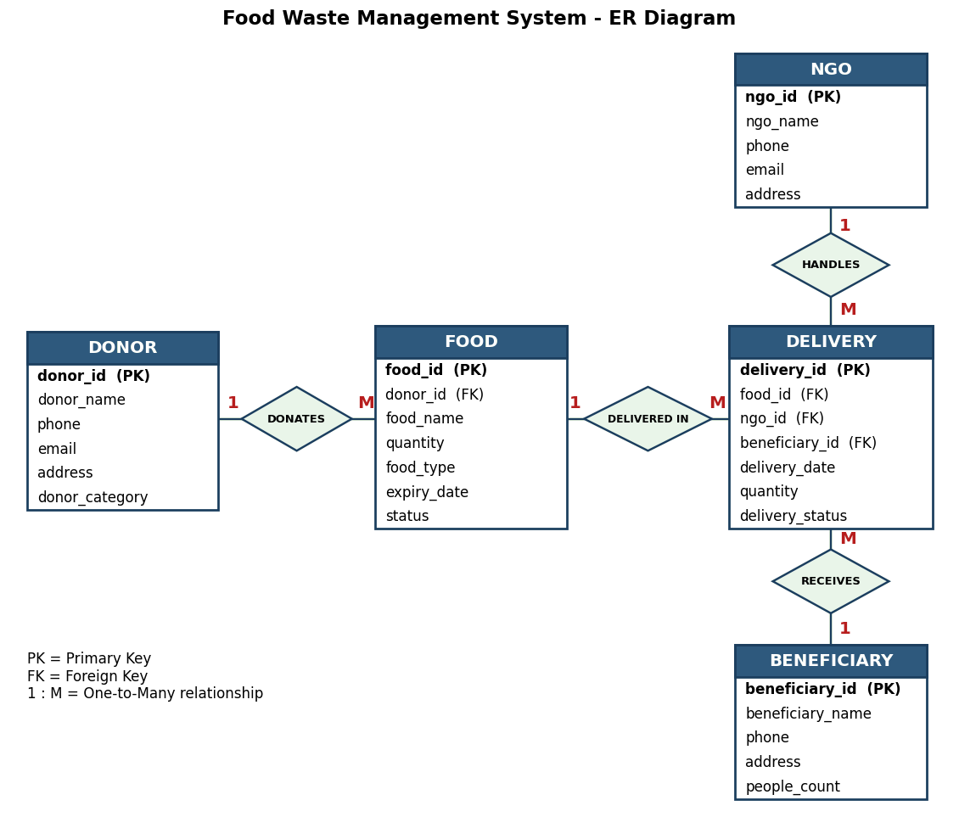
ER Diagram
5 entities: Donor, Food, NGO, Beneficiary, Delivery
4 one-to-many relationships
Delivery holds the foreign keys of Food, NGO and Beneficiary
Notes:
Delivery links Food, NGO and Beneficiary. All relationships are one-to-many.

Slide 5
Normalization
Rough design
1NF
2NF
3NF
One table with all donor, food, NGO, beneficiary and delivery data. Heavy repetition and anomalies.
All values atomic, no repeating groups.
Single-attribute key delivery_id, so no partial dependency.
Transitive dependencies removed by splitting into 5 tables.
Result: Donor, Food, NGO, Beneficiary, Delivery. Every determinant is a candidate key.
Notes:
One big table had repeated donor, NGO and beneficiary data. Transitive dependencies were removed to reach 3NF.

Slide 6
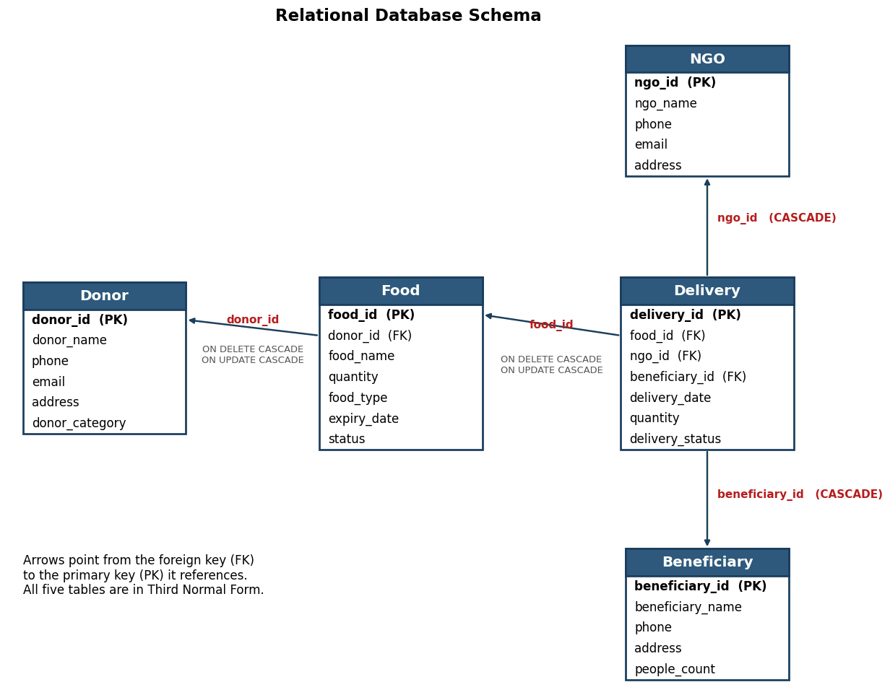
Database Schema and Constraints
Primary keys with AUTO_INCREMENT
Foreign keys: ON DELETE CASCADE, ON UPDATE CASCADE
CHECK: food quantity >= 0, delivery quantity > 0
DEFAULT: status Available, delivery In Transit
NOT NULL on all names
Notes:
Foreign keys cascade, so deleting a food item also removes its deliveries.

Slide 7
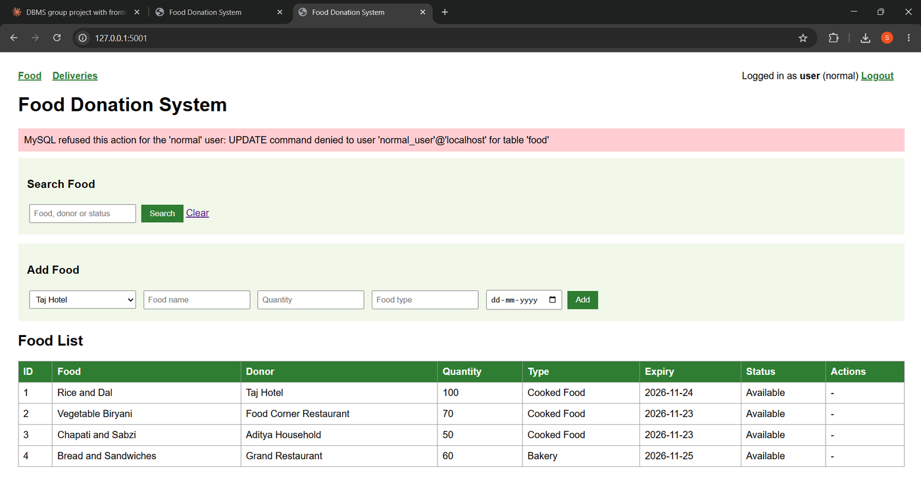
DCL: Admin and Normal Users
admin_user
ALL PRIVILEGES on the database: view, add, edit, delete.
normal_user
SELECT on all tables, INSERT on Food, EXECUTE on AddDelivery. UPDATE and DELETE are denied.
MySQL refuses an UPDATE from normal_user
Notes:
The website connects to MySQL as admin_user or normal_user, so MySQL itself enforces the privileges.

Slide 8
Trigger and Stored Procedure
Trigger after_delivery_insert
Procedure AddDelivery
AFTER INSERT ON Delivery
UPDATE Food
SET quantity =
quantity - NEW.quantity
WHERE food_id = NEW.food_id;
(also sets status to Delivered
when stock reaches 0)
read stock from Food
IF food not found
-> error "Food item not found"
ELSEIF qty > stock
-> error "Not enough stock"
ELSE
INSERT INTO Delivery ...
(trigger then reduces stock)
Simplified view; full code is in the report (Chapters 10 and 11).
Notes:
Show the trigger and procedure in Workbench. Stock drops automatically after a delivery.

Slide 9
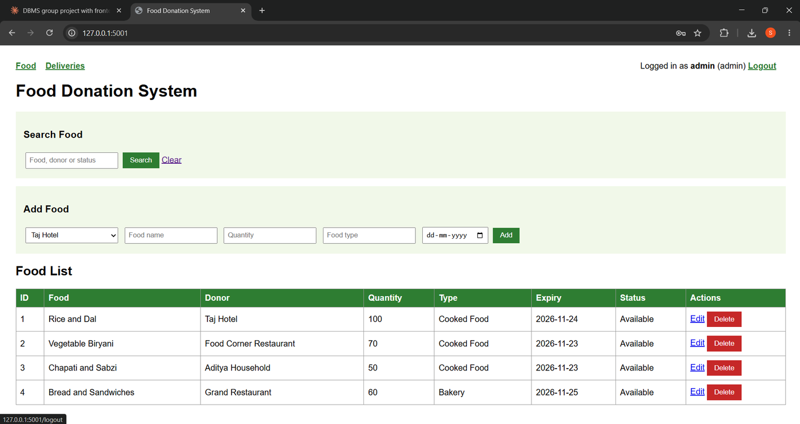
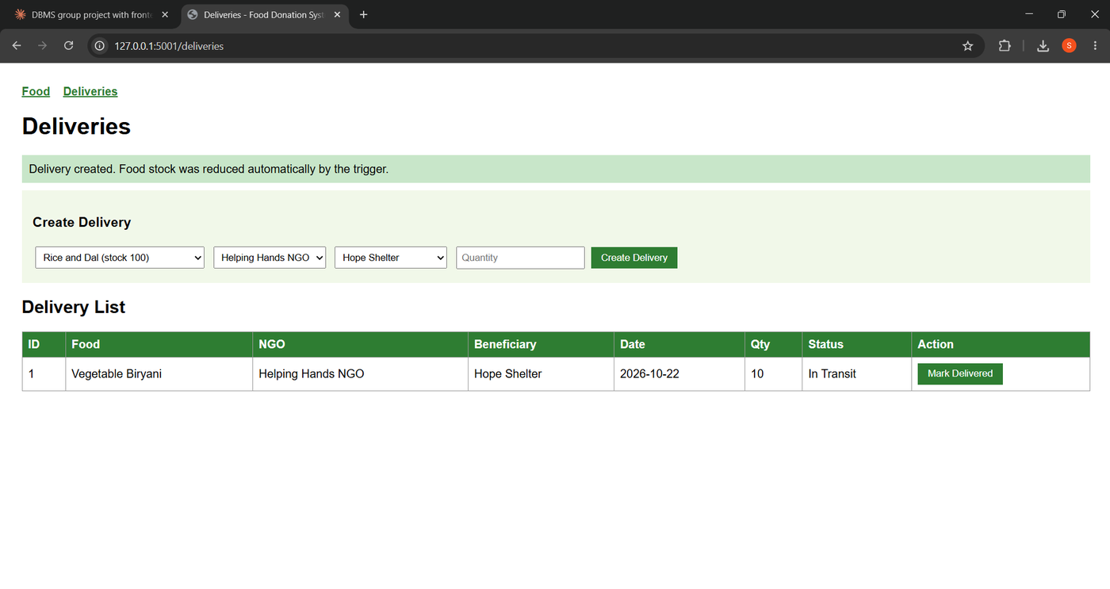
Front End and Validation
Search, add, edit and delete food; create and track deliveries
Validation: required fields, quantity at least 1, expiry date not in the past, delete confirmation
Login: Admin sees Edit and Delete, Normal user does not
Notes:
Demo order: login as admin, search, add, edit, delete, create delivery, then login as user.

Slide 10
Conclusion and Future Scope
A normalised 5-table MySQL database with cascading keys
Trigger and procedure keep stock correct inside the database
DCL privileges separate Admin and Normal users
Future: expiry alerts, nearest-NGO matching, donor registration, password hashing
Code: github.com/siddheshpatilnew/food-donation-dbms
Thank you
Notes:
Thank the guide and invite questions.

